Slide 1
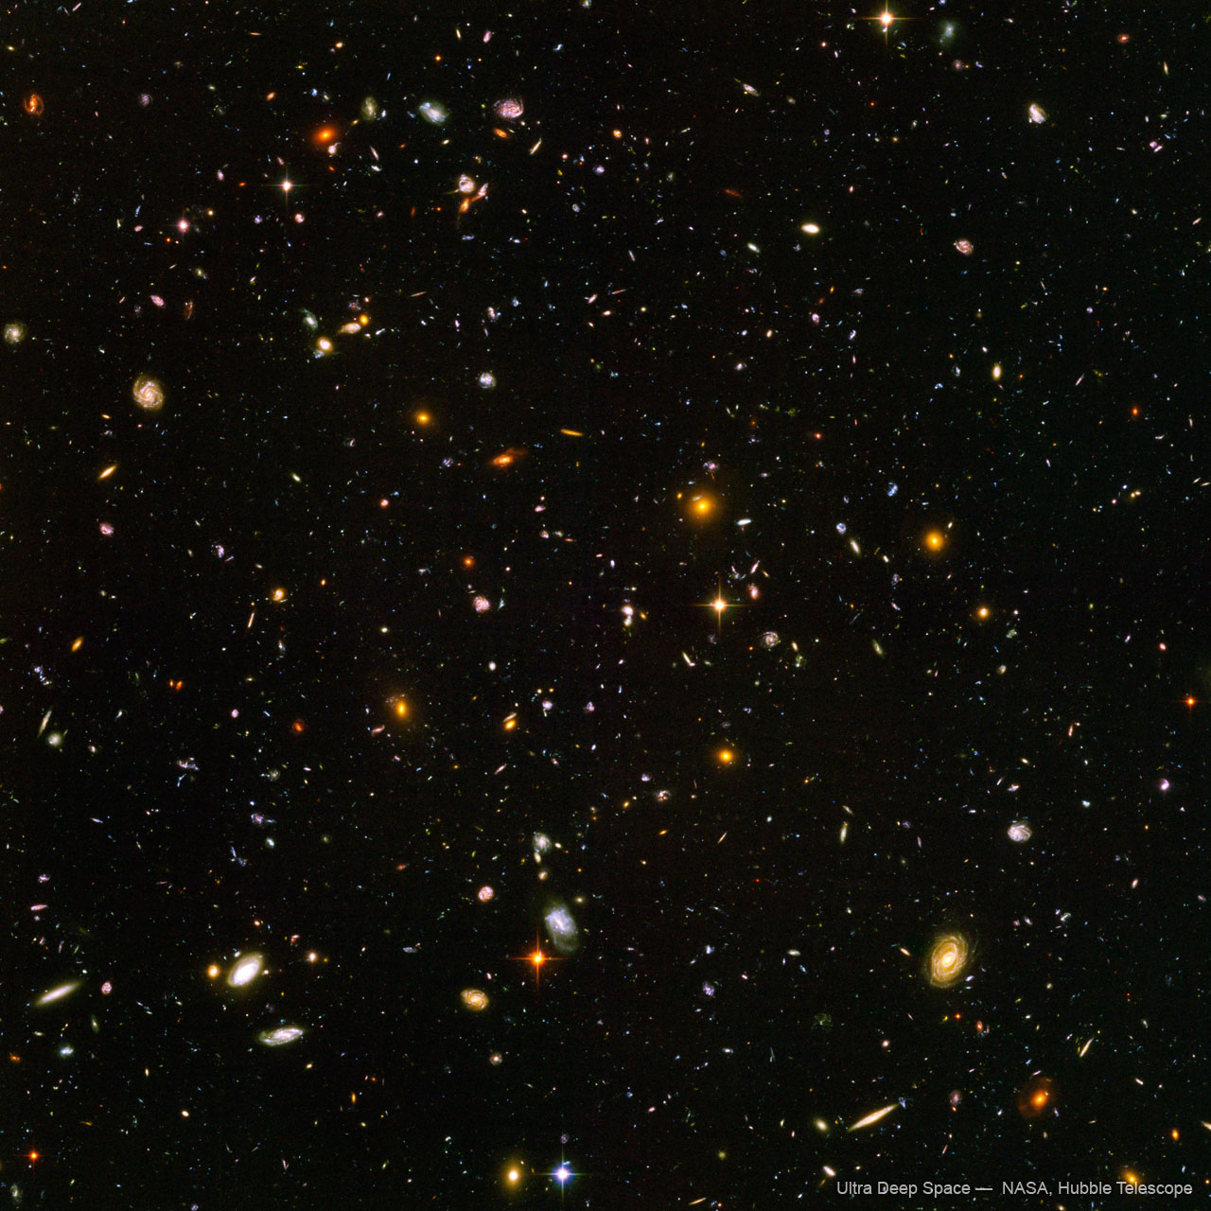
Peter Thorpe

Slide 3
What is abstract art?
A painting or sculpture that does not represent a person, place or thing in the natural world.

